Slide 1

KAGGLE COMPETITION: MOVIES RECOMMENDATION

Slide 2
TEAM_TS3_UNSUPERVISED LEARNING
TEAM MEMBERS
John Bosman
John Sekgobela
Mokitlana Rinkie Sekgobela
Samuel Tsabadi

Slide 3
Introduction
Data science- scientific methods, processes, algorithms to extract knowledge.
Regression algorithms with the aim to accurately a person's rating of an unseen movie based on their historic choices.
Help movie viewers to get the best movies faster.

Slide 4
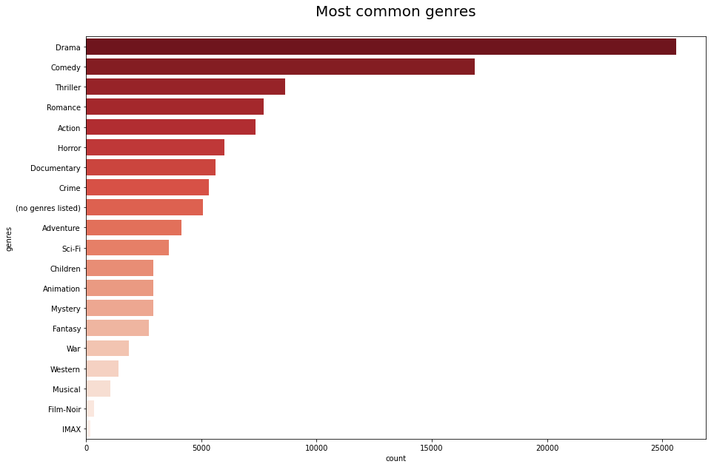
Data analysis (EDA)
Drama
Comedy
Thriller
Romance
Action

Slide 5
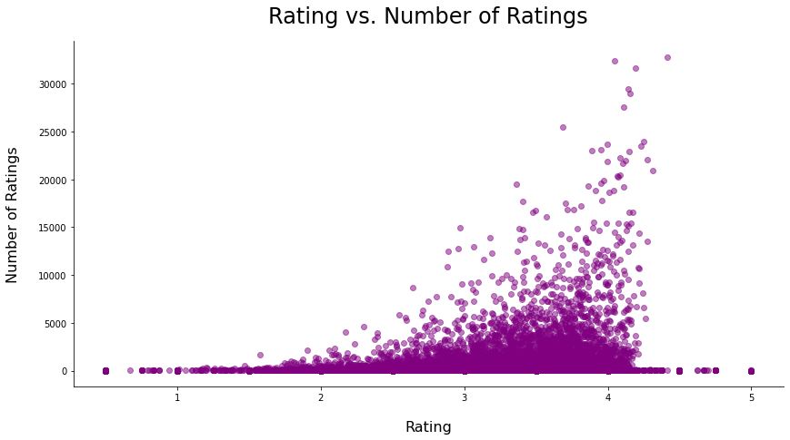
Visualization of data
Visualization by ratings

Slide 6
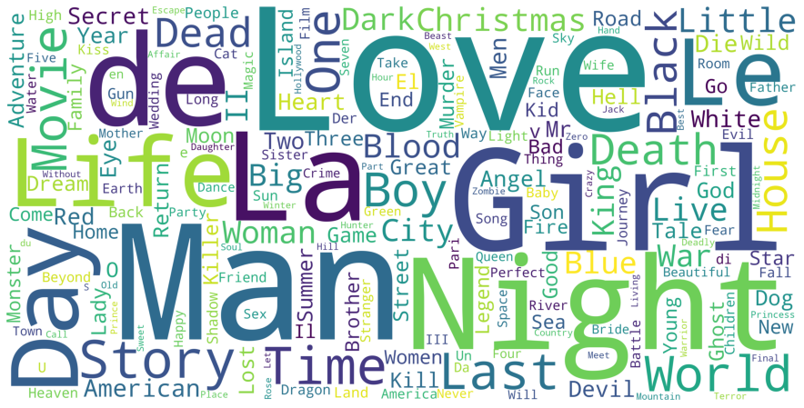
Visualization of data
Visualization by popular word in the movie title

Slide 7
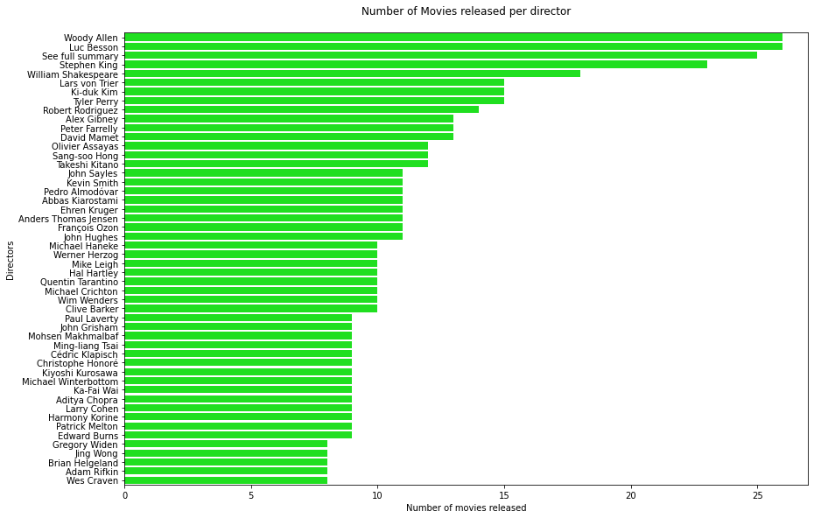
Visualization of data
Visualization per movie director

Slide 8
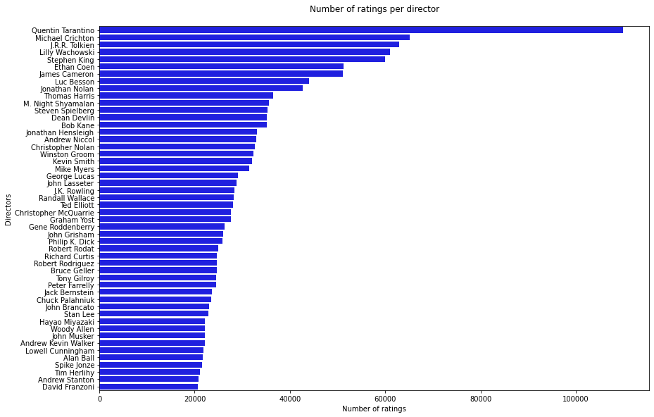
Visualization of data
Visualization per director rating

Slide 9
Data preparation
Genres into different columns
Assign 1 to all columns present in genres
No need for genres and movie names
Check for nulls after merging and drop them

Slide 10
Concluding remarks
The models tried and tested were SVD, Optimized SVD and SVDpp...
It was concluded that the best model for the data sets used is Optimized SVD.

Slide 11
Acknowledgements
Special thanks to Trevor Senyane for his supervision over the team.

Slide 12

THANK YOU

